Slide 1
Question
Write an assembly program to find the sum of all scores for each test and store the respective totals in SUM1, SUM2, and SUM3.

Slide 2
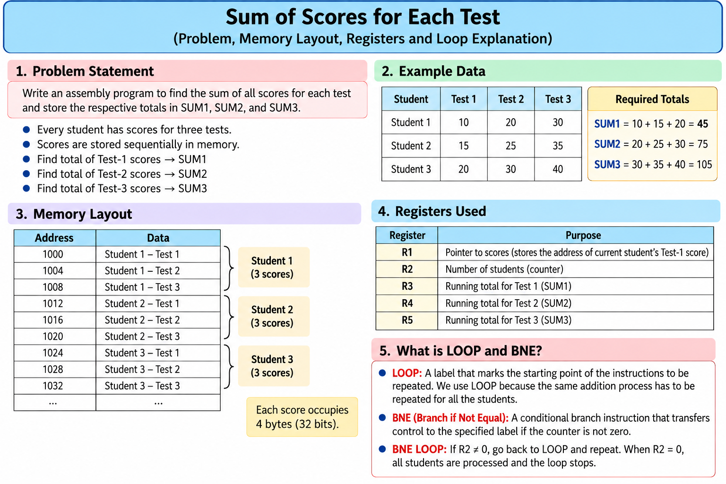

Slide 3
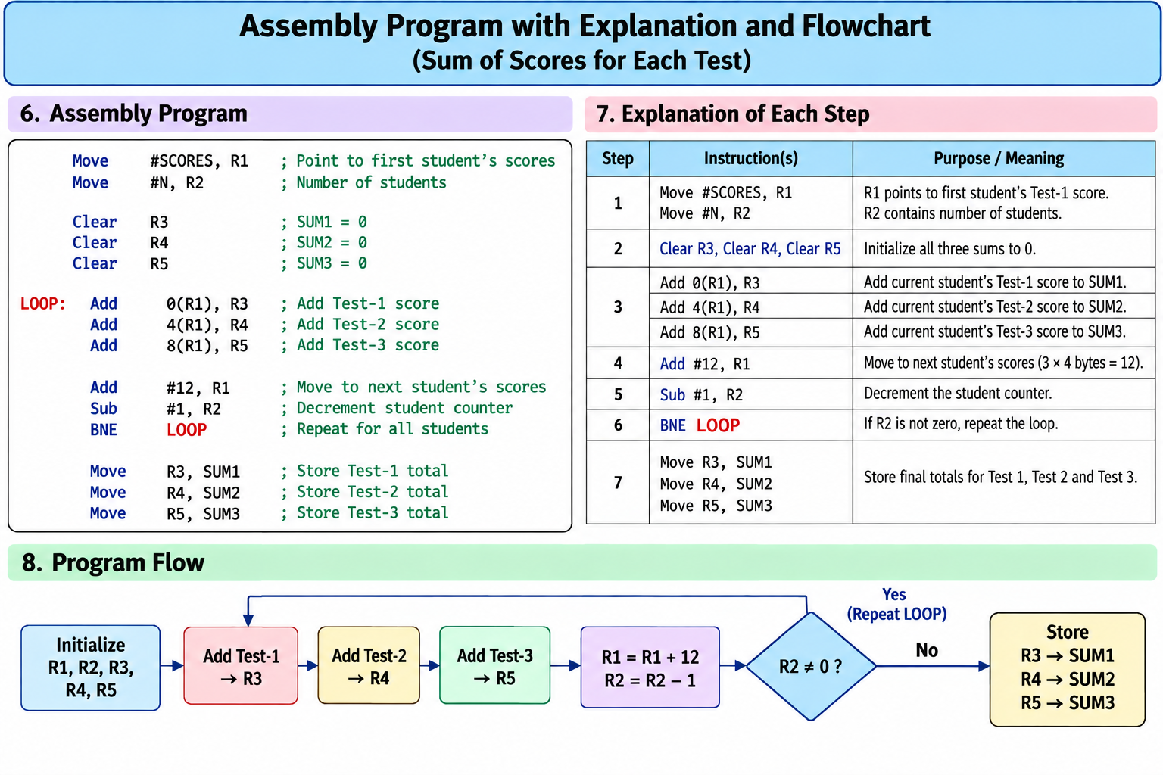

Slide 4
LOOP:A LOOP repeats the same set of instructions until a condition is satisfied.
Why used?
To repeat the addition for all n numbers.
BNE
BNE = Branch if Not Equal
It checks whether the counter has reached zero.
R2 ≠ 0 → Go back to LOOP
R2 = 0 → Stop the LOOP
LOOP → Repeat the process
R1 → Points to next number
R2 → Counts numbers remaining
R3 → Stores the sum
BNE LOOP → Repeat until R2 = 0

Slide 5
SUBROUTINES
Meaning of Subroutine
A subroutine is a sequence of instructions used to perform a specific task.
It is a small part of a larger program.
It can be called whenever the particular task is required.
After completing the task, control returns to the calling program.
It avoids writing the same instructions repeatedly.
Subroutine = A small program used to perform a specific task.

Slide 6
2. Need for Subroutines
Subroutines are useful because they:
Promote code reuse.
Avoid repetition of instructions.
Reduce program size.
Make programs modular.
Make debugging easier.
Simplify program development and maintenance.
Write the task once and use it whenever required.

Slide 7
3. Calling a Subroutine
The main program uses a CALL instruction to invoke a subroutine.
CALL transfers control from the main program to the starting address of the subroutine.
The subroutine performs the required task.
After completion, RETURN transfers control back to the calling program.
Basic Flow
Main Program → CALL → Subroutine → RETURN → Main Program
CALL = Go to the subroutine
RETURN = Come back to the main program

Slide 8
Return Address –When a subroutine is called, the processor leaves the main program.
Therefore, the processor must remember where it has to return after completing the subroutine.
This address is called the Return Address.
It is generally the address of the instruction immediately following the CALL instruction.
The return address must be saved before entering the subroutine.
Example
1000 CALL SUB
1004 ADD R1, R2
1008 SUB R3, R4
At address 1000, the subroutine is called.
After completing the subroutine, execution should continue from 1004.
Therefore:
Return Address = 1004
Ask students:
“After completing SUB, where should the processor come back?”
Answer: 1004
Return Address = Address where execution continues after the subroutine finishes.

Slide 9
5. Link Register (LR):LR stands for Link Register.
It is a processor register that may be used to store the return address.
When the subroutine finishes, the saved address can be used to return to the calling program.
Using the previous example:
Return Address = 1004
Therefore:
LR ← 1004
After completing the subroutine, the processor uses the return address to continue from 1004.
LR → Where should I return?
PC → Which instruction should be executed next?

Slide 10
6. CALL and RETURN Operations
CALL:CALL performs two important operations:
Saves the return address.
Transfers control to the subroutine.
RETURN:
Uses the saved return address.
Transfers control back to the calling program.
Flow
CALL
↓
Save Return Address
↓
Go to Subroutine
↓
Execute Subroutine
↓
RETURN
↓
Continue Main Program

Slide 11
7. Parameter Passing
A subroutine usually requires some data to perform its task.
The data supplied to a subroutine is called a parameter.
Parameter = Data given to a subroutine for processing.
Parameters can commonly be passed using:
Registers
Stack
For example, if a subroutine calculates:
A + B
then the values of A and B must be supplied to the subroutine.

Slide 12
8. Pass by Value
In Pass by Value, the actual value of the data is passed to the subroutine.
Changes made to the received value inside the subroutine normally do not change the original variable.
Example
Suppose:
A = 10
Passing 10 to the subroutine is Pass by Value.
Remember
Pass by Value = Give the actual value.

Slide 13
9. Pass by Reference
In Pass by Reference, the address of the data is passed.
The subroutine uses the address to access the original data.
Example
Suppose:
A = 10
and A is stored at address:
2000
Then:
Pass by Value → Give 10
Pass by Reference → Give 2000
Value → Give the data
Reference → Give the address

Slide 14
10. Stack
A stack is a memory structure based on the LIFO principle.
LIFO means Last In, First Out.
The last item placed on the stack is the first item removed.
Simple example
Think of a stack of plates.
The last plate placed on the top is normally the first plate removed.
During subroutine execution, the stack can store:
Return addresses
Parameters
Saved register contents
Local variables
Simple definition:
Stack = Temporary storage based on Last-In-First-Out.

Slide 15
Stack Pointer (SP)
SP stands for Stack Pointer.
It is a processor register.
It points to the current top of the stack.
SP changes whenever information is added to or removed from the stack.
SP → Where is the top of the stack?

Slide 16
12. PUSH Operation
PUSH means placing data onto the stack.
For a 32-bit downward-growing stack, one 32-bit word occupies:
32 bits = 4 bytes
Therefore, when one word is pushed:
SP ← SP − 4
Then the value is stored on the stack.
PUSH = Put data onto the stack.

Slide 17
13. POP Operation
POP means removing/retrieving data from the stack.
After retrieving one 32-bit word:
SP ← SP + 4
Remember
PUSH → SP − 4
POP → SP + 4
The 4 is used because:
32 bits = 4 bytes

Slide 18
14. Saving and Restoring Registers
A subroutine may need to use processor registers.
Suppose the main program already has an important value in R1, but the subroutine also needs R1.
If the subroutine directly changes R1, the original value may be lost.
Therefore:
Before changing the register → SAVE its value
Before returning → RESTORE its value
Save before changing → Restore before returning.
The stack can be used to save these register values.

Slide 19
15. Nested Subroutines
Sometimes one subroutine can call another subroutine.
This is called a Nested Subroutine Call.
Example
MAIN → SUB1 → SUB2
When SUB2 finishes:
SUB2 → SUB1
When SUB1 finishes:
SUB1 → MAIN
Therefore:
MAIN → SUB1 → SUB2 → SUB1 → MAIN
Each return address must be preserved correctly.
The stack is useful for storing these return addresses.
Nested Subroutine = One subroutine calls another subroutine.

Slide 20
16. Stack Frame – Important
During execution, a subroutine may require space for its own information.
A Stack Frame is the private working area allocated on the stack for a subroutine.
It may contain:
Parameters
↓
Return Information
↓
Saved Registers
↓
Local Variables
Stack Frame = Private workspace of a subroutine in the stack.
When the subroutine is executing, it uses this space for its required information.

Slide 21
17. Frame Pointer (FP)
FP stands for Frame Pointer.
FP provides a convenient fixed reference for the current stack frame.
It helps the processor access:
  Parameters
  Local variables
  Other information in the stack frame
Very simple difference
SP → Where is the top of the stack?
FP → Provides a fixed reference to the current stack frame.

Slide 22
18. LISTADD Example
LISTADD is an example used to understand how a subroutine works.
A list of numbers is supplied to the subroutine.
The subroutine accesses the list elements.
It adds the elements one by one.
A register can be used as a counter to keep track of the number of elements.
The final sum is produced.
Control returns to the calling program.
LISTADD helps students understand:
Parameter Passing + Registers + Counter/Loop + CALL + Subroutine Execution + RETURN
You don't need to spend too much time on the theory of LISTADD. Use the actual program/example to demonstrate these concepts.

Slide 23
Complete Subroutine Operation
MAIN PROGRAM
↓
CALL
↓
Save Return Address
↓
Pass Parameters
↓
Save Registers if required
↓
Use Stack / Stack Frame
↓
Execute Subroutine
↓
Restore Registers
↓
RETURN
↓
Continue Main Program

Slide 24
Term | Simple meaning
Subroutine | Small program for a specific task
CALL | Go to the subroutine
RETURN | Come back
Return Address | Address where execution should continue
LR | Holds the return address
Parameter | Data given to the subroutine
Pass by Value | Give the actual value
Pass by Reference | Give the address
Stack | Temporary LIFO storage
SP | Points to top of stack
PUSH | Put data on stack
POP | Take data from stack
Nested Subroutine | One subroutine calls another
Stack Frame | Private workspace of subroutine
FP | Fixed reference for the stack frame

